Slide 1

Exploring the impact of COVID-19 pandemic on tech workers’ mental health
Monash Data Analytics Bootcamp, 2024
Project 1, Group 4
James Radford, Katrina Witt, Joyce Xu, and Erin Nicol

Slide 2
Executive Summary
Notes:
Erin :
Tech workers experience precarious employment, unpredictable working hours, sedentary, and often socially isolating working conditions.
Research on psychosocial working conditions suggests that these factors are likely to have significant impacts on workers' mental and physical health.
Increasingly, research is suggesting that workplace cultures that encourage workers to disclose their mental health issues to colleagues and supervisors may improve the likelihood that workers will disclose mental health conditions, leading to better long-term outcomes for tech workers.
- The aims of this project are therefore to explore the factors that impact on tech workers mental health over two observation periods, before the COVID-19 pandemic (2014) compared with during the COVID-19 pandemic (2020-2022).

Slide 3
Data Source
Notes:
Joyce:
Our data was sourced from the example health data provided (.csv format) within the suggested material on Bootcampspot
Tech Workers were interviewed and provided insights into their mental health status and the level of support they get from their current and previous employer,
They identified how comfortable they feel discussing issues with peers and supervisors.
Four data streams were used, 2014, 2020, 2021 & 2022. This gave us the ability to compare surveys pre and post covid.

Slide 4
OSMI 2014, 2020,2021, 2022 Mental Health in Tech Survey Results
https://osmhhelp.org/research.html
OSMH:
Open Sourcing Mental Health,
Non-for-profit dedicated to promoting mental wellness in tech industry .
Pre-COVID Period:
2014 survey: largest survey done on mental health in the tech industry, 1259 respondents
COVID Affected Period:
2020-2022 surveys: merged into one dataset, initially 475 respondents, filtered to 255 responses to match the target participant of 2014 data
Notes:
Joyce:
Aim: explore the factors which, have impact on tech employee’s mental status

Slide 5
Method
Notes:
Joyce:
Our data was sourced from the example health data provided (.csv format) within the suggested material on Bootcampspot
Tech Workers were interviewed and provided insights into their mental health status and the level of support they get from their current and previous employer,
They identified how comfortable they feel discussing issues with peers and supervisors.
Four data streams were used, 2014, 2020, 2021 & 2022. This gave us the ability to compare surveys pre and post covid.

Slide 6
Datatype: .csv file imported into Pandas Data frame for each individual year.
Research Questions:
Prevalence of mental health conditions
Geographic distribution of the respondents
How comfortable they feel discussing issues in the workplace(supervisors VS co-workers)
Factors correlated mental status, type of work or family history
Employers’ attitudes towards wellness programs under COVID impact
Differences in survey data structure:
Survey questions with equivalent meanings manually selected and filtered
Harmonise the responses’ options
Visualisation: Matplotlib plot to visualize distribution, proportion-based approach
Chi2 test of independence of variables:
Done for questions with identical answer options after harmonization
2014 data --- Expected Frequencies; 2020-2022 data – Observed Frequencies
Chi-square statistic and p-value to explore COVID impact

Slide 7
What is the self-reported prevalence of mental health conditions amongst tech industry workers?
Notes:
James

Slide 8
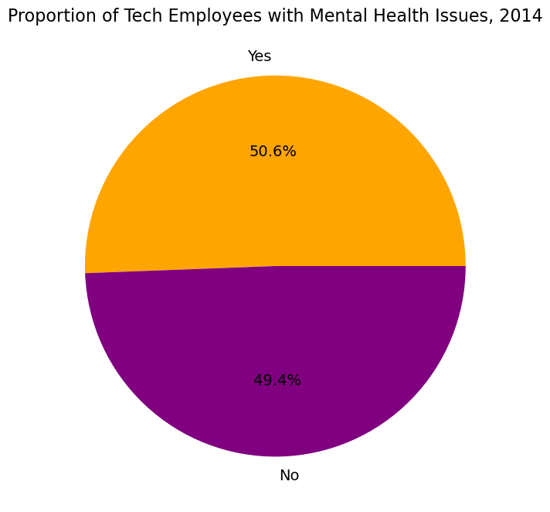
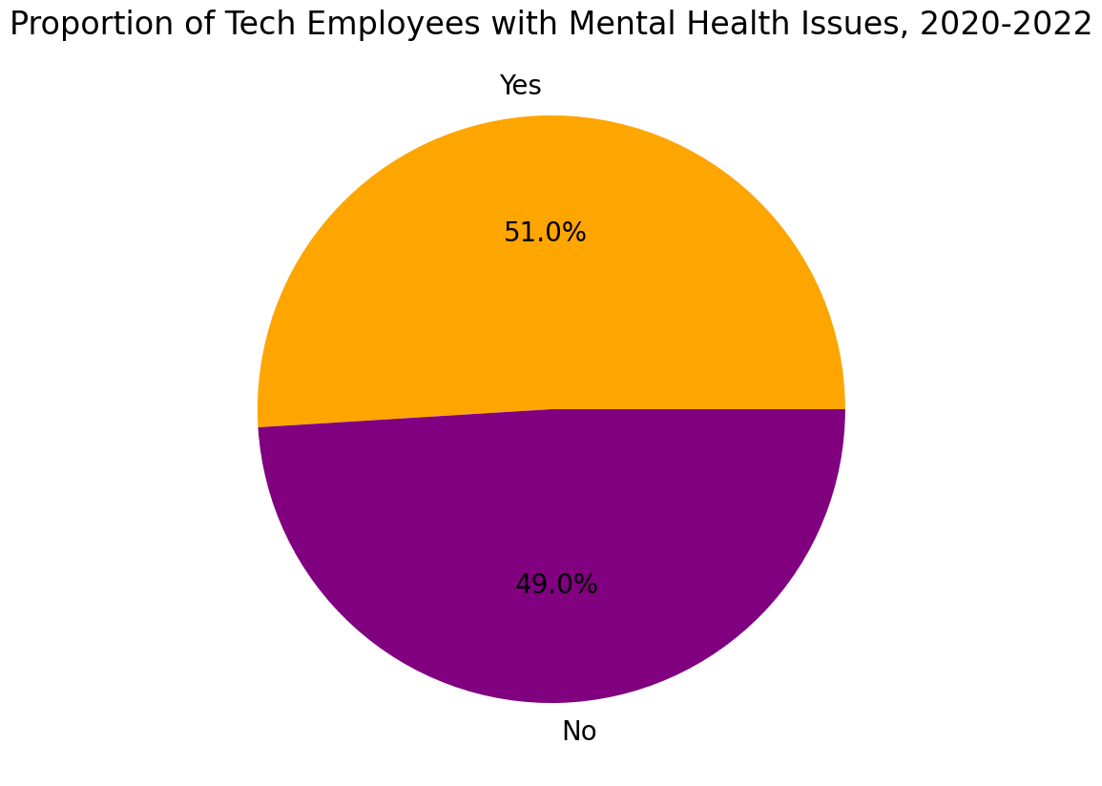
Pre-Pandemic, 2014:
Post-Pandemic, 2020-2022:
No significant difference:
Chi2 = 0.15, df = 1, p = 0.696
Notes:
James: Similar results between pre and post pandemic as shown by our Chi2 result which out p value is much larger than 0.05.

Slide 9
2. How does this compare across different countries?
Notes:
James

Slide 10
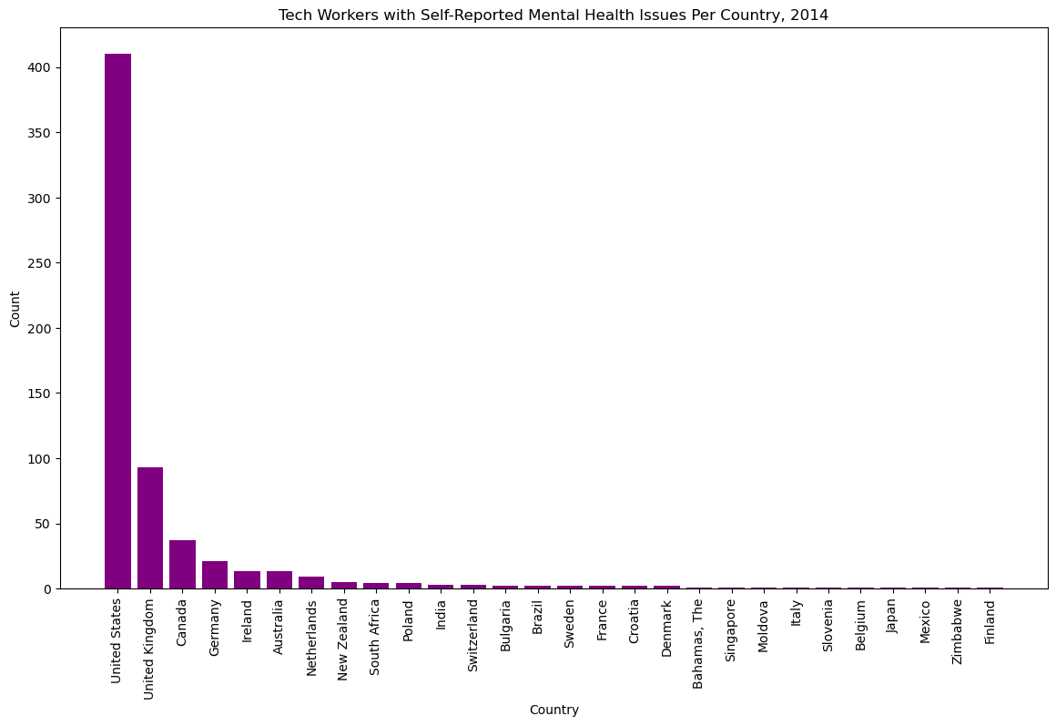
Pre-Pandemic, 2014:
Notes:
James: This shows the count of self-reported mental health issues per country as tech workers. Clearly the US has the highest number of cases, this purely because the survey was more widely distributed in the US, however this is only an assumption

Slide 11
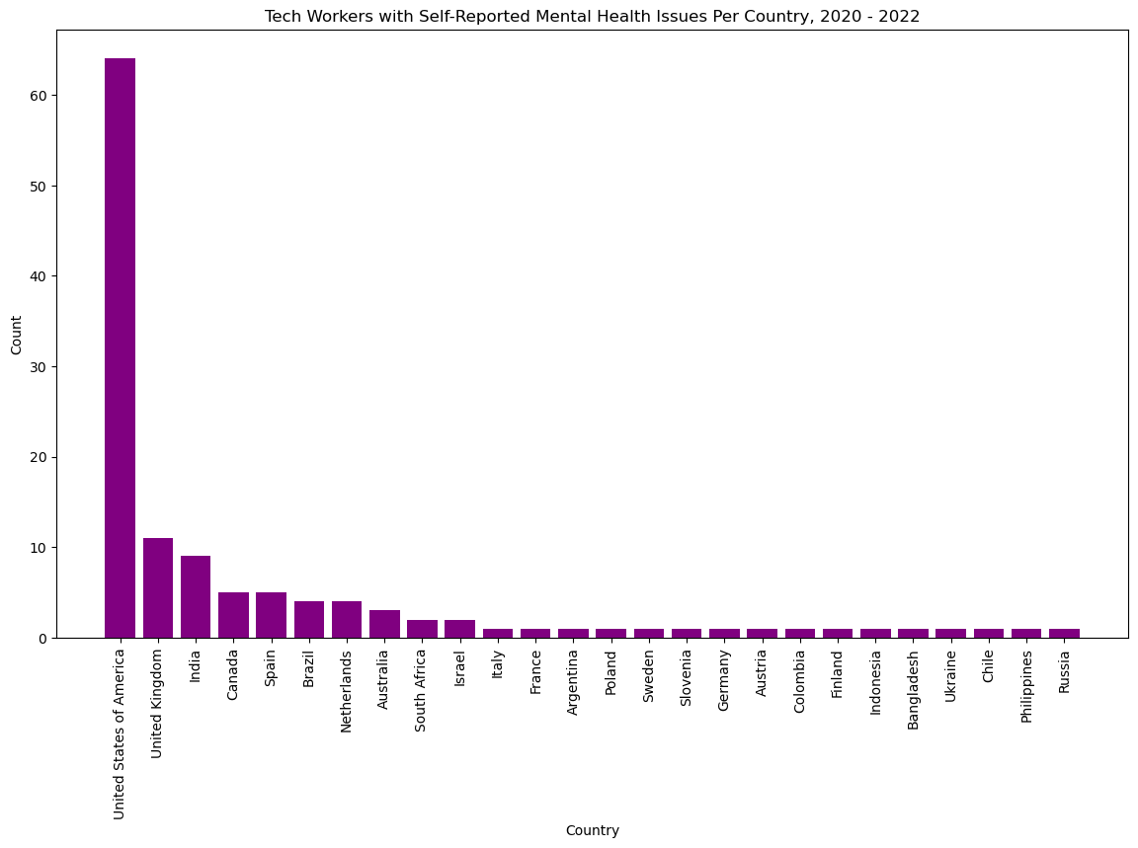
Post-Pandemic, 2020-2022:
Notes:
James: Similar results as above, majority of survey results came from the US, noticeably, India jumped 8 places.

Slide 12
3. What is the proportion of tech employers that offer wellness programs?

Slide 13
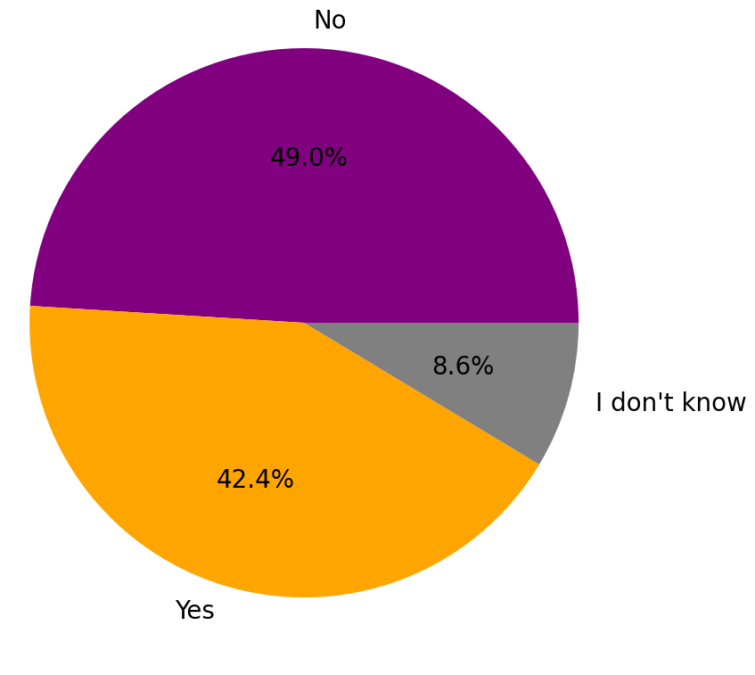
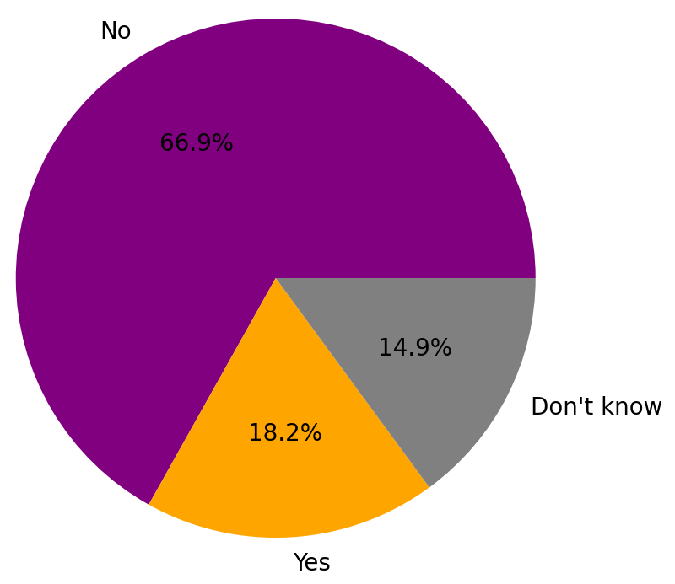
Pre-Pandemic, 2014:
Post-Pandemic, 2020-2022:
Significant difference:
Chi2 = 72.29, df = 2, p < 0.001
Notes:
James : Significant increase in tech companies that provide mental health wellness programs, this may be attributed to greater mental health awareness post pandemic, or greater communication between employers and employees.

Slide 14
4. Does the prevalence of self-reported mental health conditions vary between remote vs. office-based workers?

Slide 15
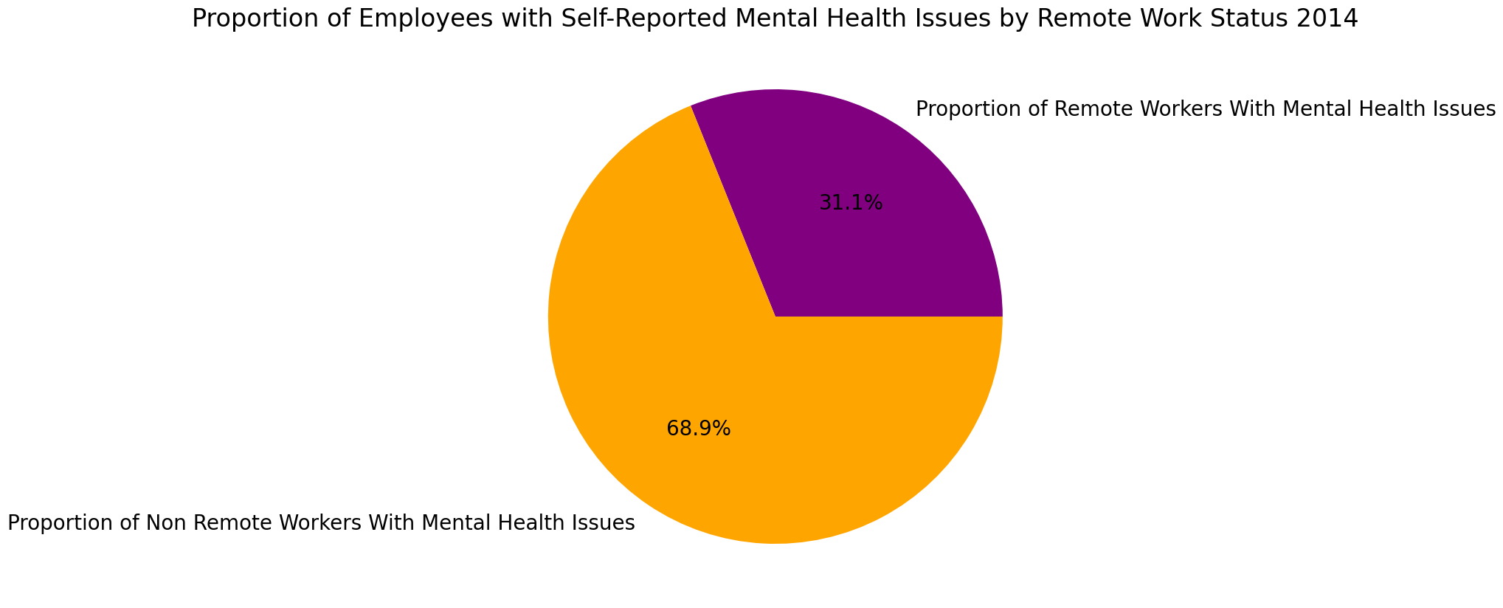
Pre-Pandemic, 2014:
NOTE: Analyses for the post-pandemic period were not possible as this was not assessed in 2020 to 2022
Notes:
Mental health issues more prevalent in office-based workers pre-covid, this result is unexpected. Only one datasource (2014) for this analysis which I will expand on further in the limitations section.

Slide 16
5. Does the prevalence of self-reported mental health conditions vary between those with and without a family history of mental illness?

Slide 17
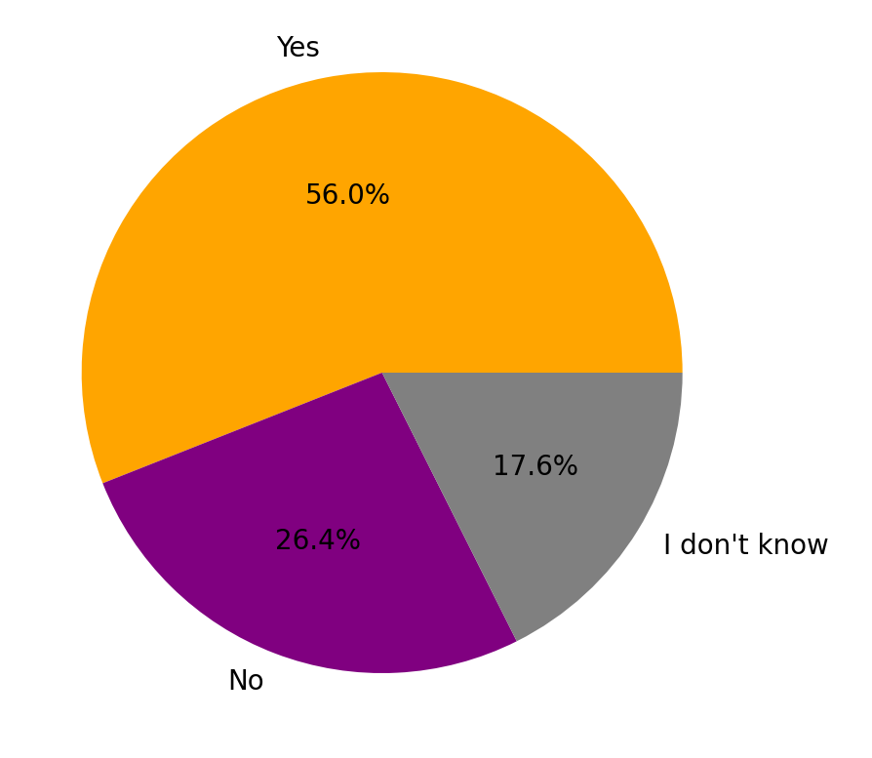
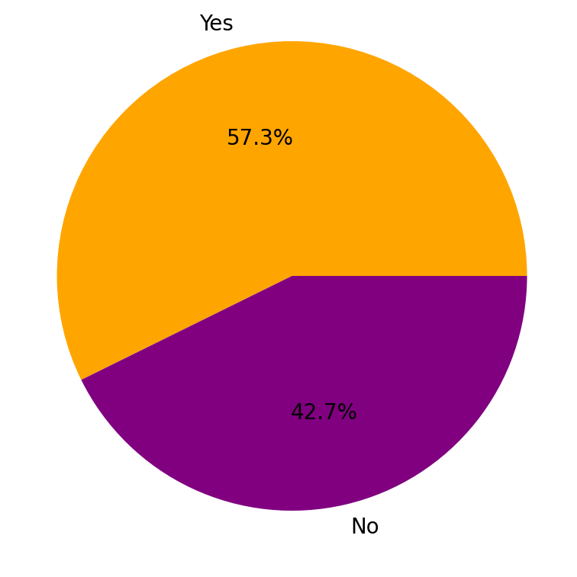
Pre-Pandemic, 2014:
Post-Pandemic, 2020-2022:
Given the differences in data, we chose not to complete the Chi2 analysis as this would misrepresent the data.
Notes:
Results show that the pandemic didn’t really impact the percentage of tech workers with mental health issues where there was a family history of mental health issues. Also unexpected. Unable to complete Chi2 due to the different degrees of freedom.

Slide 18
6. How likely are those with self-reported mental health conditions to disclose issues to supervisors?

Slide 19
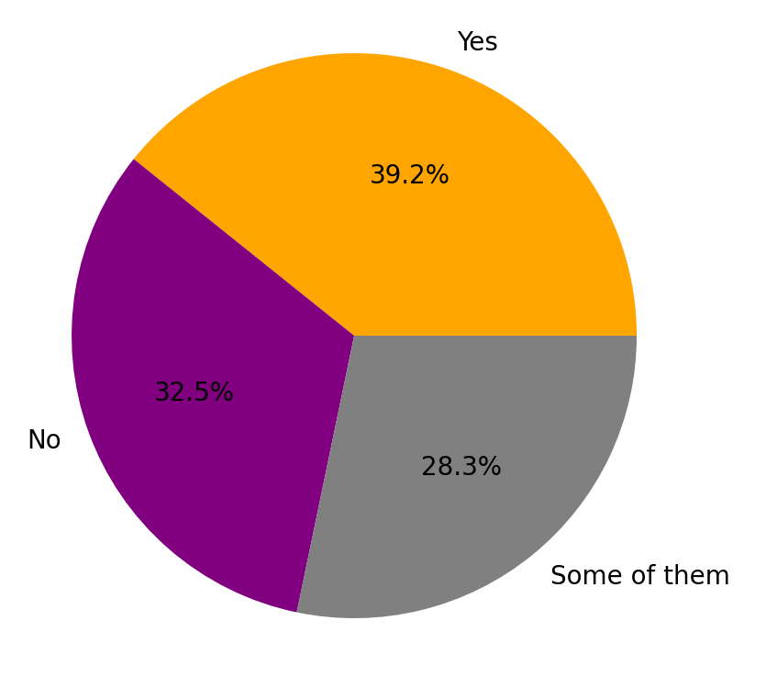
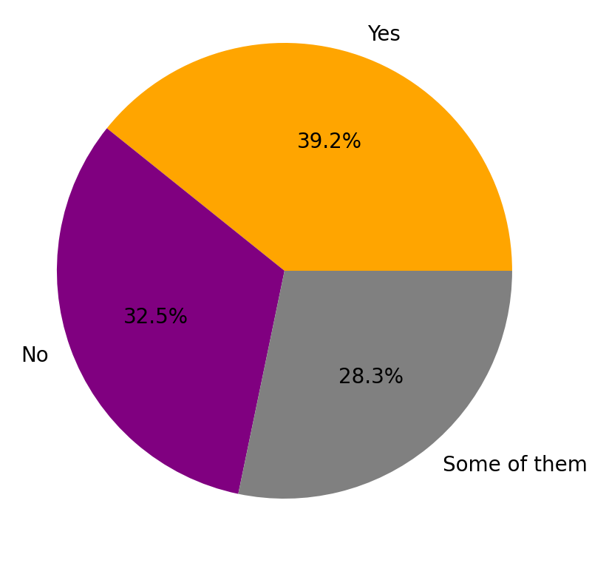
Pre-Pandemic, 2014:
Post-Pandemic, 2020-2022:
No significant difference:
Chi2 = 0.31, df = 2, p = 0.896
NOTE: Proportions are the same by chance!
Notes:
James : No change, despite the counts in the dataframes being completely different. We didn’t just duplicate the graphs we swear…

Slide 20
7. How likely are those with self-reported mental health conditions to disclose issues to co-workers?

Slide 21
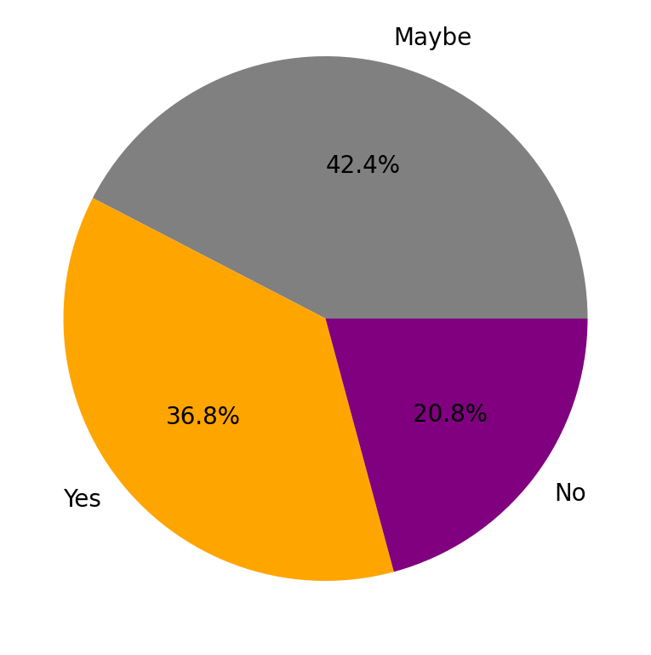
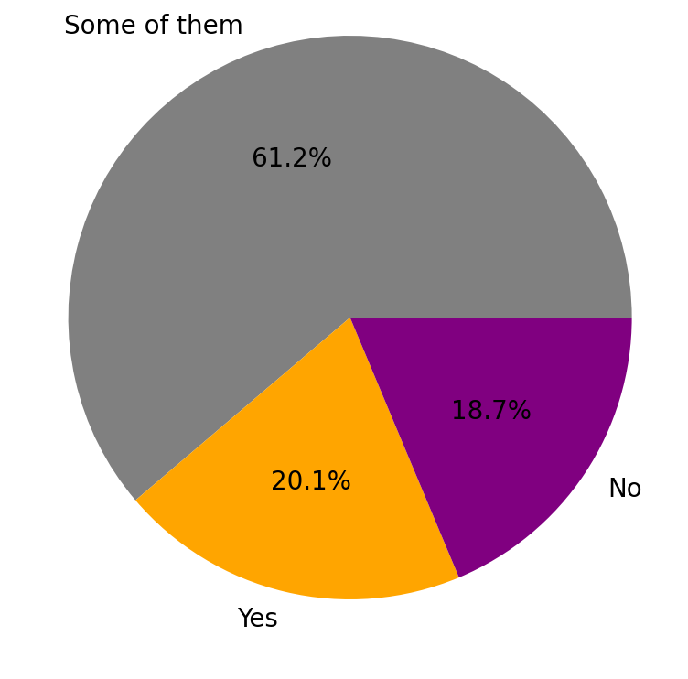
Pre-Pandemic, 2014:
Post-Pandemic, 2020-2022:
Significant difference:
Chi2 = 19.34, df = 2, p < 0.001
Notes:
James : Increase in percentage of employees willing to talk to co-workers by 16.8%, mental health discussion seems much more open post pandemic.

Slide 22
Conclusions

Slide 23
Conclusions:
No significant increase in proportion of tech workers self-reporting MH issues post-COVID-19
More tech employees are offering MH wellness programs to employees post-COVID-19
Surprisingly, majority of tech workers reporting MH issues were office based (but we couldn't compare post-COVID-19 due to data unavailability)
Despite greater awareness and availability of MH programs, tech workers were no more comfortable in disclosing their issues to a supervisor pre- and post-COVID-19
However, willingness to disclose to a co-worker did significantly improve post-COVID-19
Limitations:
Divergence in questions and response options employed in surveys before and after COVID, making it inappropriate to utilize the chi-square test for comparing distribution variance.
2. The way mental health among tech workers is determined, relies on whether they sought help from a medical professional. However, COVID-19-related restrictions on selective medical services might introduce bias against those genuinely experiencing mental health issues.
3. Majority of respondents from USA with very different healthcare model to, e.g., AUS
4. Changes may also reflect processes, such as greater awareness of programs and policy changes, rather than being wholly attributable to COVID-19
Notes:
Katrina: Conclusions & Limitations?

Slide 24
Future Directions
Notes:
James

Slide 25
Time series analysis could help to identify whether COVID-19, or another factor (e.g., local industrial policies), influences the proportions of tech workers reporting MH issues.
Using a dimensional approach to determine MH issues (e.g., scores on a MH screener) would provide greater statistical power.
3. Development of a standardised data dictionary for comparison from previous years.
Notes:
Joyce/Erin??

